Slide 1
Porous materials for trapping and detection of space contaminants
CCMPP-2023
Guillaume Rioland, Delphine Faye
CNES
September, 2023
guillaume.rioland@cnes.fr

Slide 2


Table of contents
Porous materials for trapping and detection of space contaminants – CCMPP 2023
Introduction
Trapping
  Porous materials selection
  Shaping
Detection
  Porous materials selection
  Implementation
Conclusion

Slide 3
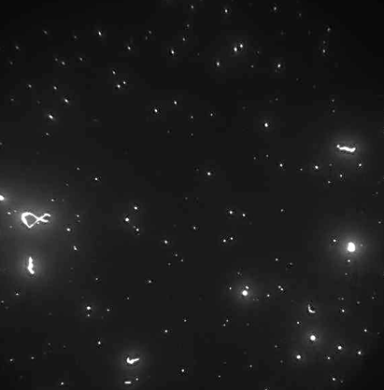
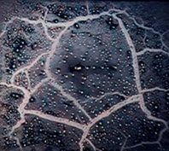
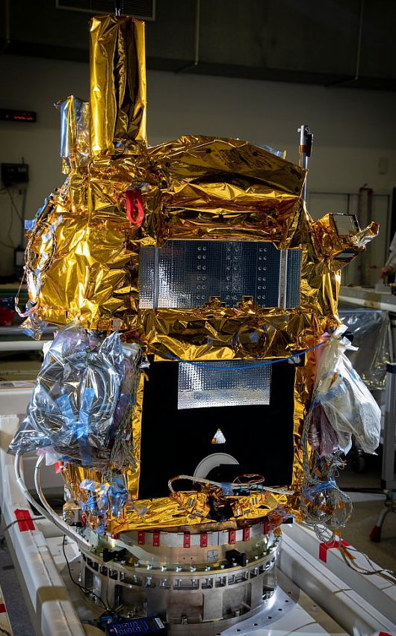
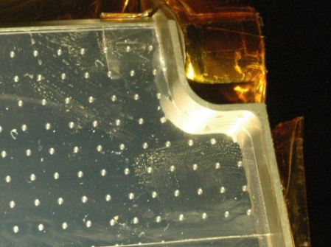
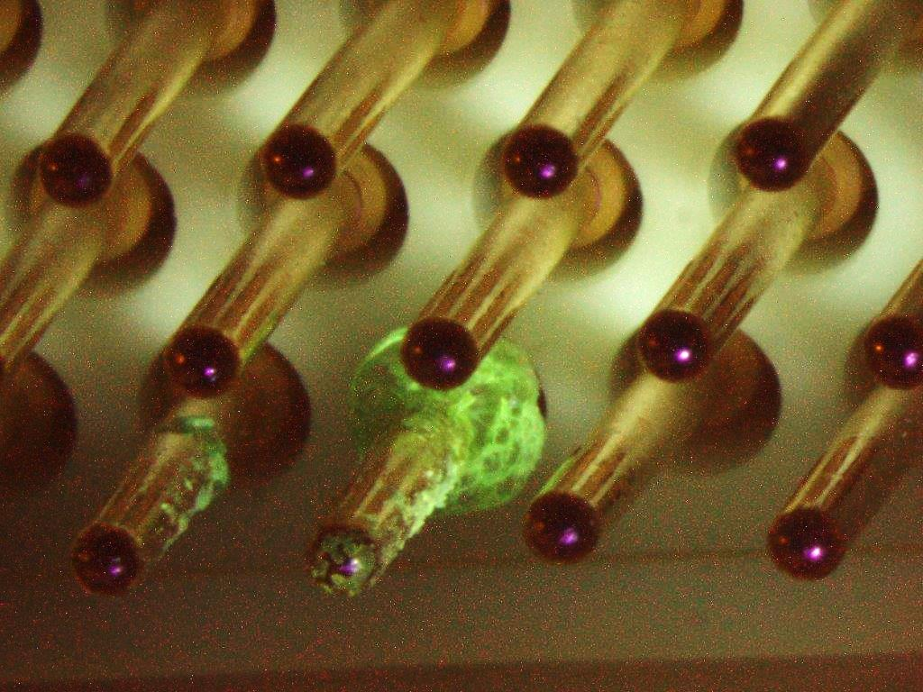
Introduction
Porous materials for trapping and detection of space contaminants – CCMPP 2023
Contaminant (ECSS-Q-ST-70-01): any unwanted molecular or particulate matter (including microbiological matter) on the surface or in the environment of interest, that can affect or degrade the relevant performance or life time
particulate contaminant
visible deposit of particles, fibers, chips…
(µm to a few mm)
mainly on ground
molecular contaminant
accumulation of monolayers (10 to 100 nm)
mainly in flight, sometimes on ground
Consequences of molecular contamination
Degradation of thermal control surfaces
Performance loss of optical systems
Loss of electrical contact
Increase of internal pressure
Cleanliness levels vs expected performance
Budgets to be defined and to be respected on ground and in flight
How to proceed?
© CNES
migration of cleaning residues
Solder flux on connector
© CNES
© CNES

Slide 4
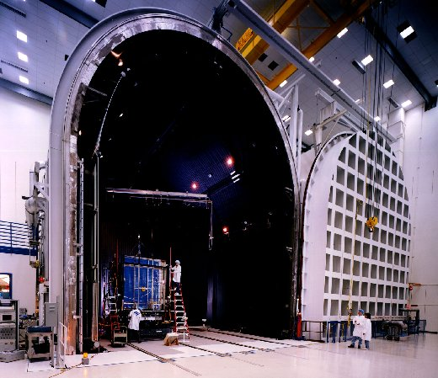
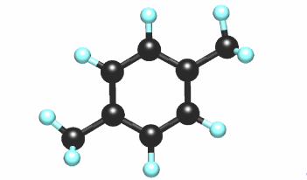
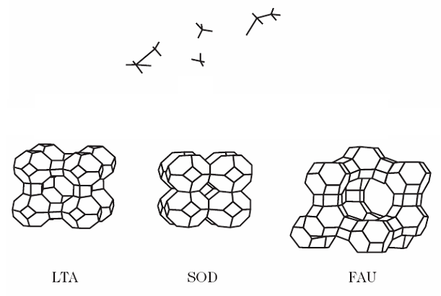
Trapping
Porous materials for trapping and detection of space contaminants – CCMPP 2023
Conventional methods for contamination mitigation:
Bake-out of the payload / platform
Low outgassing materials
Specific design
Venting holes
Expensive and time-consuming
Limited effectivness
Other solution: trapping of contaminants
Use of molecular adsorbent
Tetrahedra TO₄
T = Si^{IV}, Al^{III}
Charcoal
Zeolites
Porous alumina
Mesoporous silica
Low P
X
© CNES
H. Kirsch, control of molecular contamination by adsorption on porous solids, PhD UHA – CNES, 2005

Slide 5
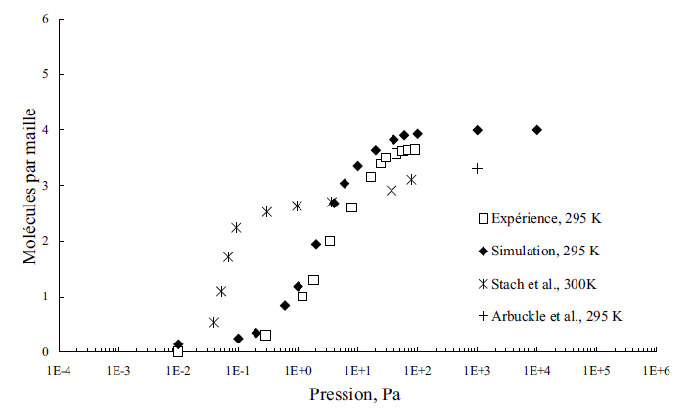
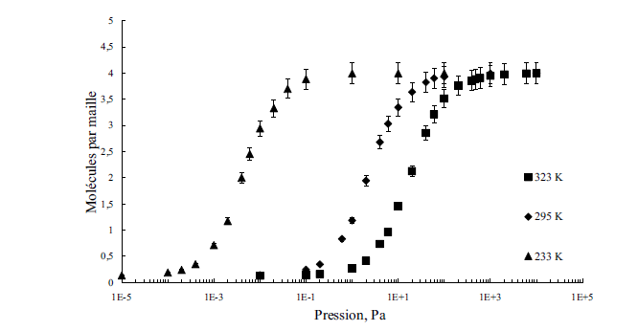
Trapping
Porous materials for trapping and detection of space contaminants – CCMPP 2023
How to choose the right zeolite?
Simulation
µVT ensemble. One Monte Carlo step ➔ translation or rotation of molecules
Used for the study of liquid-vapor stability + calcul of vapor pressure
Adsorbate-adsorbate / intramolecular / adsorbate-adsorbent interactions
Cristallographic models ➔ Fitch, Mortier and Olson ➔ structure, cell coordinates, cations location…
Molecule per cell
Cyclohexane adsorption in silicalite-1
D_{cyclohexane} > D_{pores}
➔ Channel intersections
Molecule per cell
Pressure (Pa)
Pressure (Pa)
Selection of zeolite (nature, Si/Al molar ratio…) to adsorb a specific contaminant
H. Kirsch, control of molecular contamination by adsorption on porous solids, PhD UHA – CNES, 2005

Slide 6
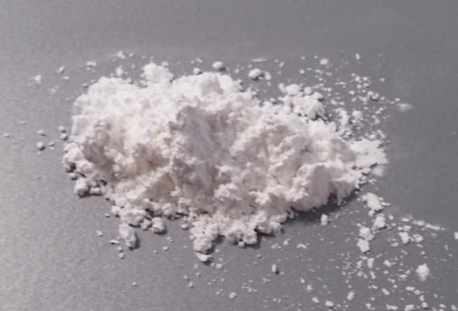
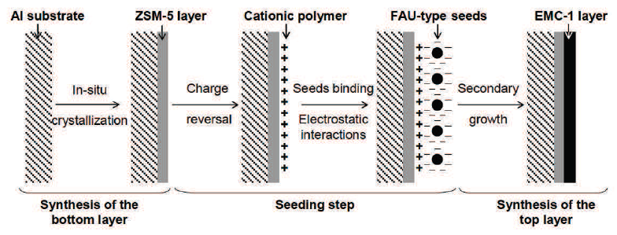
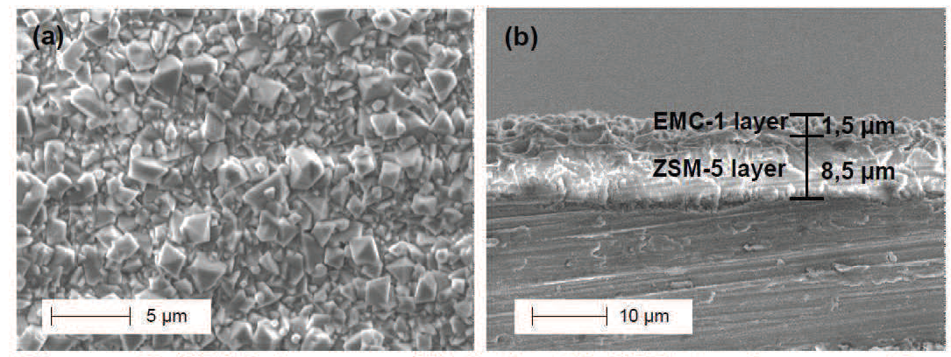
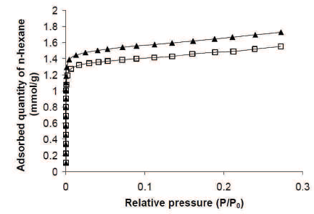
Trapping
Porous materials for trapping and detection of space contaminants – CCMPP 2023
How to use it in satellite ? Powder ➔ risk of particulate contamination
#1: Films (IS2M/CNES)
n-hexane adsorption isotherms at 25 °C of the ZSM-5 bottom layer (square) and the ZSM-5 and EMC-1 bi-layer film (triangle)
Scheme representing the overall method for the synthesis of a bi-layer film
SEM images of (a) the EMC-1 top layer surface after hydrothermal treatment on seeded substrate and (b) the thickness of the ZSM-5 and EMC-1 bi-layer film
Films with several zeolites = wider range of molecules to be trapped
T. J. Daou, N. Lauridant, G. Arnold, L. Josien, D. Faye, J. Patarin, Synthesis of MFI/EMT zeolite bi-layer films for molecular decontamination, Chemical Engineering Journal, Vol. 234, 2013, 66-73
N. Lauridant, T.J. Daou, G. Arnold, H. Nouali, J. Patarin, D. Faye, Zeolite hybrid films for space decontamination, Microporous and Mesoporous Materials, Vol. 172, 2013, 36-43
N. Lauridant, T. J. Daou, G. Arnold, M. Soulard, H. Nouali, J. Patarin, D. Faye, Key steps influencing the formation of ZSM-5 films on aluminum substrates, Microporous and Mesoporous Materials, Vol. 152, 2012, 1-8
N. Lauridant, T. Jean Daou, Gilles Arnold, Joël Patarin, Delphine Faye, MFI/∗BEA hybrid coating on aluminum alloys, Microporous and Mesoporous Materials, Vol. 166, 2013, 79-85

Slide 7
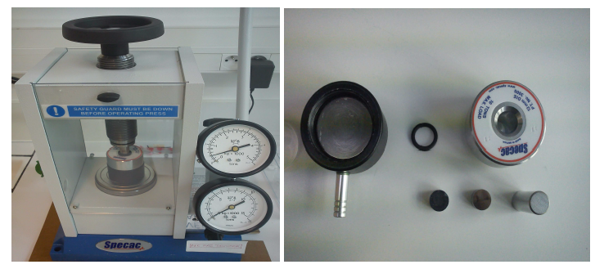
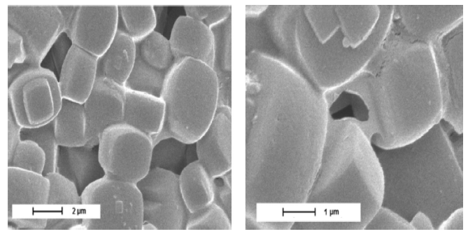
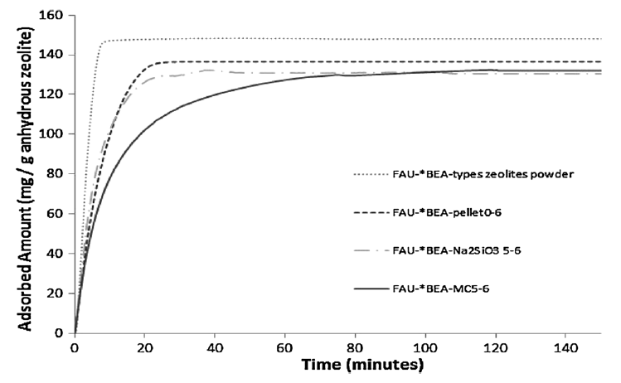
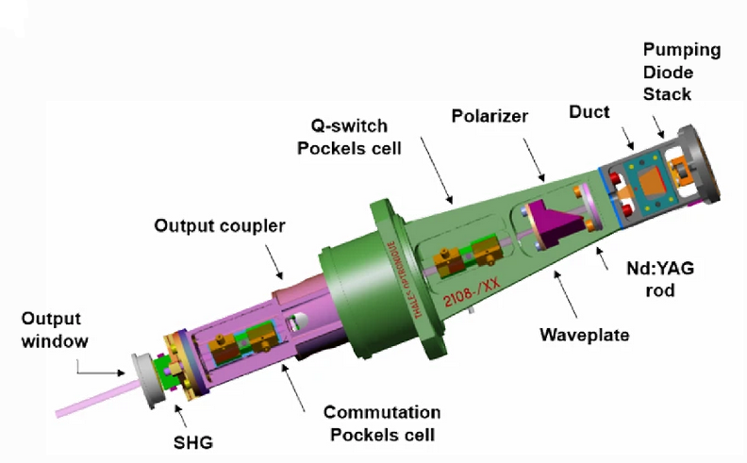
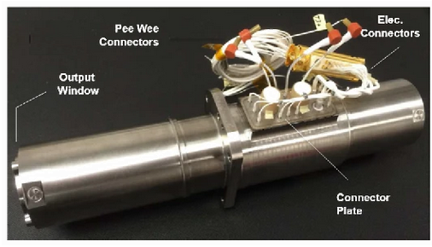
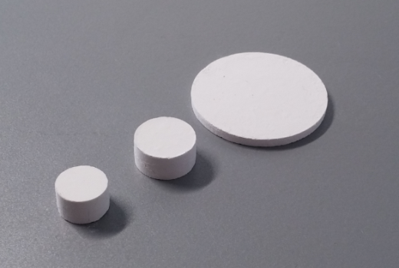
Trapping
Porous materials for trapping and detection of space contaminants – CCMPP 2023
How to use it in satellite ?
#2: Pellets (IS2M/CNES)
n-hexane adsorption isotherms at 25 °C for different formulations
Hydraulic press used for the shaping of powder
SEM images of the interactions between MFI-type zeolite and sodium silicate
Chemcam/Supercam laser cavity
Pellets with several zeolites = wider range of molecules to be trapped
G. Rioland, T. J. Daou, D. Faye, J. Patarin, A new generation of MFI-type zeolite pellets with very high mechanical performance for space decontamination, Microporous and Mesoporous Materials, Vol. 221, 2016, 167-174
G. Rioland, P. Dutournié, D. Faye, T. J. Daou, J. Patarin, Prediction of the mechanical properties of zeolite pellets for aerospace molecular decontamination applications, Beilstein Journal of Nanotechnology, Vol. 7, 2016, 1761-1771
G. Rioland, H. Nouali, T. J. Daou, D. Faye, J. Patarin, Adsorption of volatile organic compounds in composite zeolite pellets for space decontamination, Adsorption, Vol. 23, 2017, 395-403
S. Maurice, R.C. Wiens, P. Bernardi, P. et al. The SuperCam Instrument Suite on the Mars 2020 Rover: Science Objectives and Mast-Unit Description. Space Sci Rev Vol. 217, 2021, 47
D. Faye, A. Jakob, M. Soulard, P. Berlioz, Zeolite adsorbers for molecular contamination control in spacecraft, Proc. of SPIE Vol. 7794, 2010, 77940B-1

Slide 8
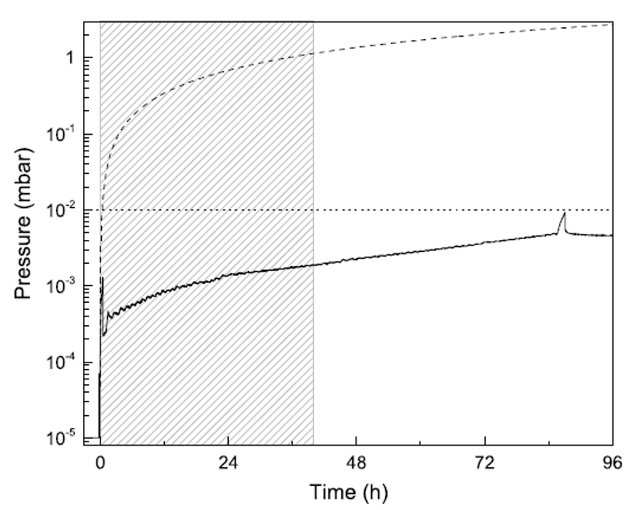
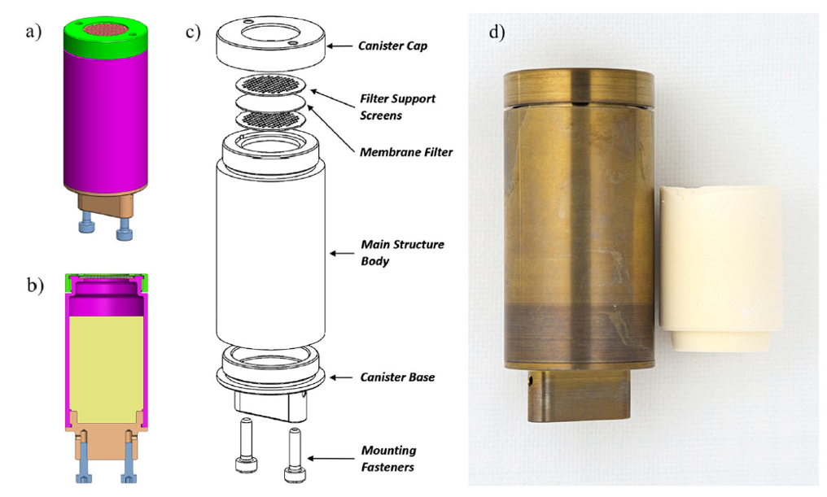
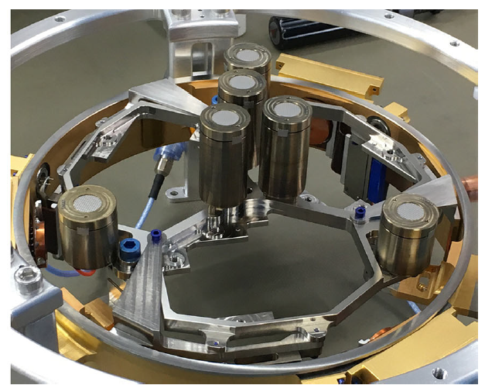
Trapping
Porous materials for trapping and detection of space contaminants – CCMPP 2023
How to use it in satellite ?
#3: Aerogel (JPL/CNES)
Different views (a,b,c) of the central getter assembly, and the development getter (d) unit adjacent to a ZLA composite molded in the canister shape
Flight instrument plate with assembled getters
Solide line = pressure profile during an adsorption test under a constant water vapor flow at RT
Dashed line = pressure without getter
Hatched area = the 14-months SEIS-equivalent time
Dotted line = pressure budget allocation
SEIS instrument (InSight Mars lander) worked very well: detection of quakes on Mars
M.P. Petkov, S.M. Jone, G.E. Voecks et al. Development of the Primary Sorption Pump for the SEIS Seismometer of the InSight Mission to Mars. Space Sci Rev, Vol. 214, 2018, 112

Slide 9
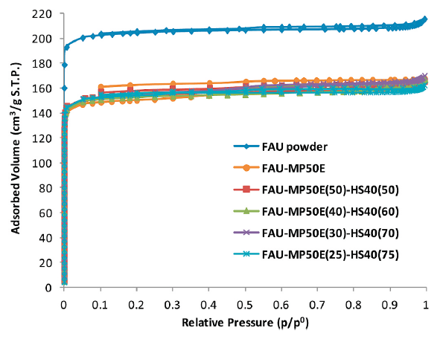
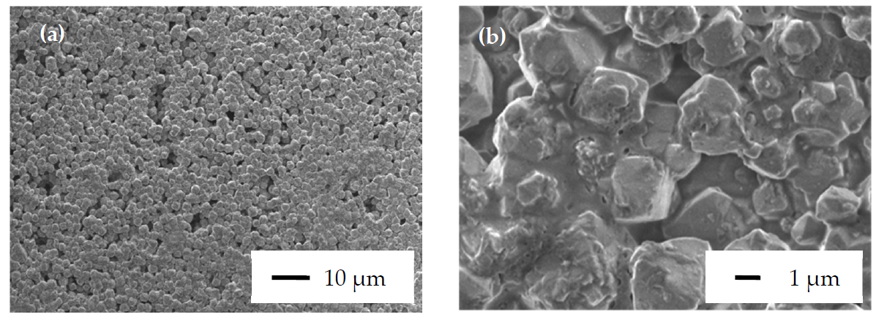
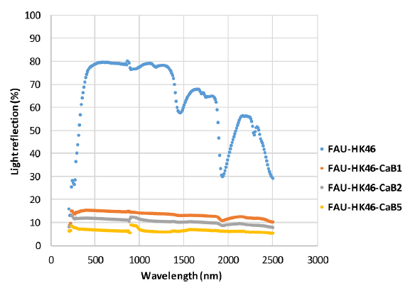
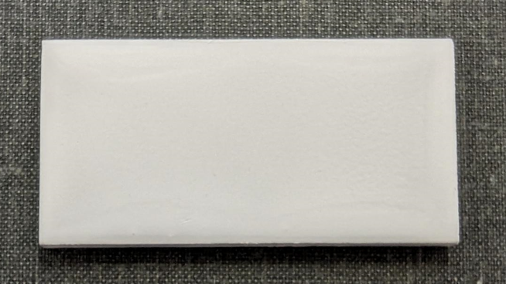
Trapping
Porous materials for trapping and detection of space contaminants – CCMPP 2023
How to use it in satellite ?
#4: Paints (IS2M/CNES)
N₂ adsorption isotherms at 77 K of different paint formulations
SEM images of a zeolite paint based on a mixture of commercial binders + zeolite + solvent
Final result ➔ addition of black pigment for straylight
Paints used in vacuum chamber (bake-out, TVAC…) to protect sensitive surfaces
M. Diboune, H. Nouali, M. Soulard, J. Patarin, G. Rioland, D. Faye, T. J. Daou, Black zeolite coatings for stray light reduction and in-orbit molecular decontamination, Microporous Mesoporous Mater., Vol. 359, 2023, 112654
M. Diboune, H. Nouali, M. Soulard, J. Patarin, G. Rioland, D. Faye, T. J. Daou, Efficient Removal of Volatile Organic Compounds by FAU-Type Zeolite Coatings. Molecules Vol. 25, 2020, 3336.
M. Diboune, H. Nouali, M. Soulard, J. Patarin, G. Rioland, D. Faye, T. J. Daou, Green hybrid zeolite coatings for on-orbit molecular decontamination, Microporous and Mesoporous Materials, Vol. 307, 2020, 110478,

Slide 10
Detection
Porous materials for trapping and detection of space contaminants – CCMPP 2023
Nature of contaminants: RGA, wipe, witness sample …➔ delay, multi-steps, uncertainty, operator dependent, location…
Need to track in situ and in real-time the nature of contaminant deposit
Sensitive porous sorbent deposited as a layer on QCM
Sorption features
Optimal affinity
Reversible sorption isotherm
Selectivity
Fast sorption kinetics
Material metrics
Thermal stability
Film processability
Environmental friendly
Commercial availability
Metal-Organic Frameworks (MOFs)
Variety of pore size / shape + functionalization
MOF@QCM as gases and Volatile Organic Compounds (VOCs) sensors: CO_{x}, NO_{x}, NH₃, H₂S, SO_{x}, BTEX, alcohols, alkanes…
No MOF-based sensors for siloxane detection

Slide 11
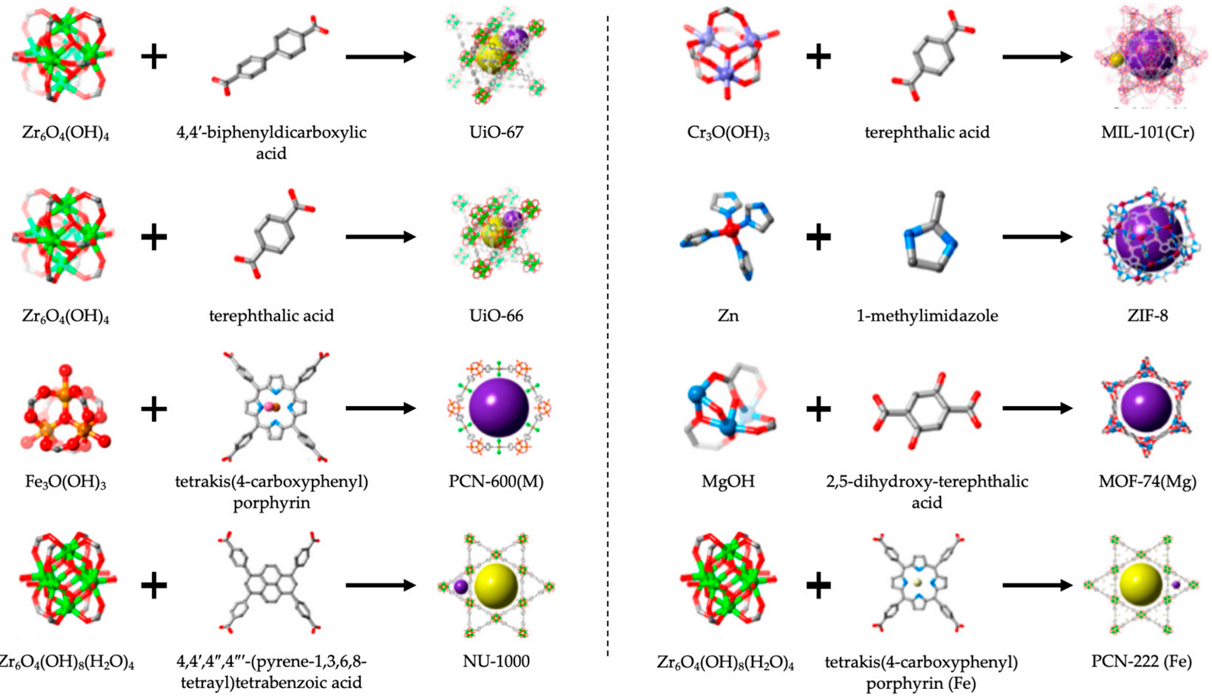
Detection
Porous materials for trapping and detection of space contaminants – CCMPP 2023
  IUPAC 2013¹: “A Metal-Organic Framework, abbreviated to MOF, is a Coordination Network with organic ligands containing potential voids.” “A coordination entity is an ion or neutral molecule that is composed of a central atom, usually that of a metal, to which is attached a surrounding array of atoms or groups of atoms, each of which is called a ligand”
  Cristallographic database:
  30 000 MOFs
  Simulation:
  130 000 MOFs
Pure Appl. Chem., 2013, 85, 8, 1715
A. Gutiérrez-Serpa, I. Pacheco-Fernández, J. Pasán, V. Pino, Metal–Organic Frameworks as Key Materials for Solid-Phase Microextraction Devices-A Review. Separations Vol. 6, 2019, 47
Notes:
“A coordination compound extending, through repeating coordination entities, in 1 dimension, but with cross-links between two or more individual chains, loops or spiro-links, or a coordination compound extending through repeating coordination entities in 2 or 3
dimensions.”

Slide 12
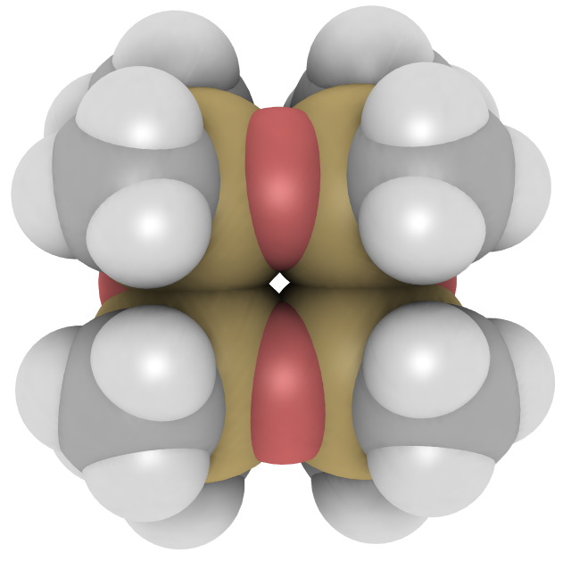
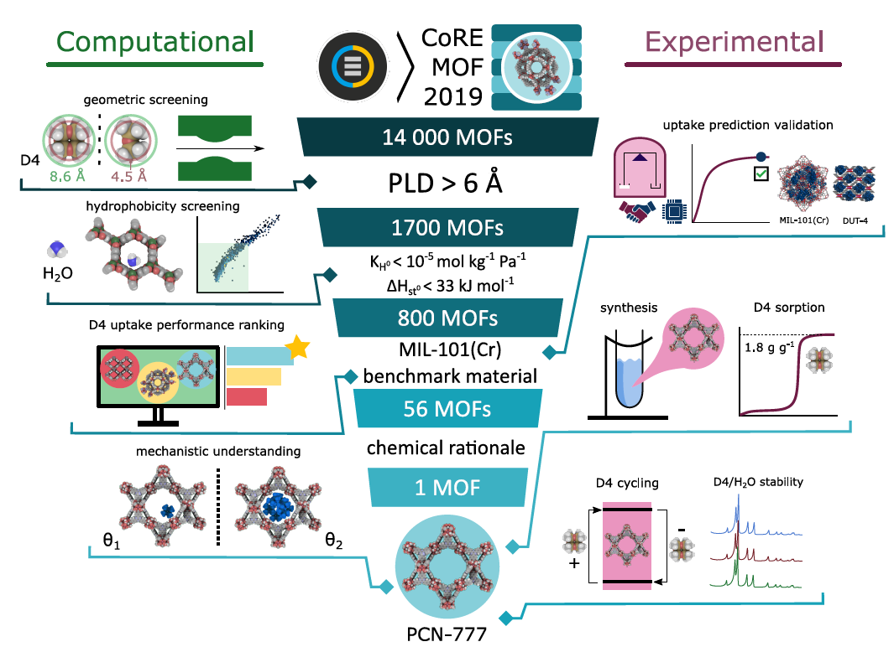
Detection
Porous materials for trapping and detection of space contaminants – CCMPP 2023
D4, Si₄O₄(CH₃)₈
Best MOF for D4 capture: PCN-777
Best MOF for D4 sensing: MIL-101 (Cr)

Slide 13

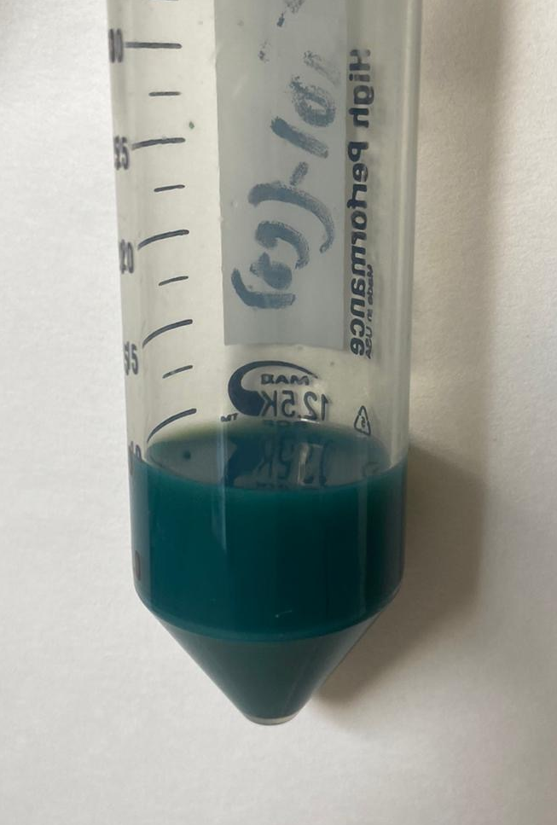

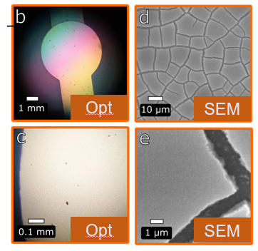
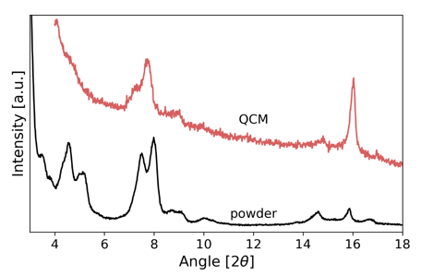
Detection
Porous materials for trapping and detection of space contaminants – CCMPP 2023
MIL-101(Cr)@QCM
EtOH suspension (ILV)
MOF deposition
Spin coating deposition
m_{MIL-101(Cr)} = 20-40 μg
F₀ = 10 MHz
Optical images
XRD
13
Notes:
For the preparation of a film of MIL-101(Cr), a colloidal suspension of MIL-101(Cr) NPs was prepared in ethanol at a concentration of 30 g / L. The MIL-101(Cr) nanoparticle film was prepared through the deposition of 50 μL of this colloidal solution by spin coating at a spinning speed of 2000 rpm for 60 s. The film was then air-dried at ambient temperature.

Slide 14
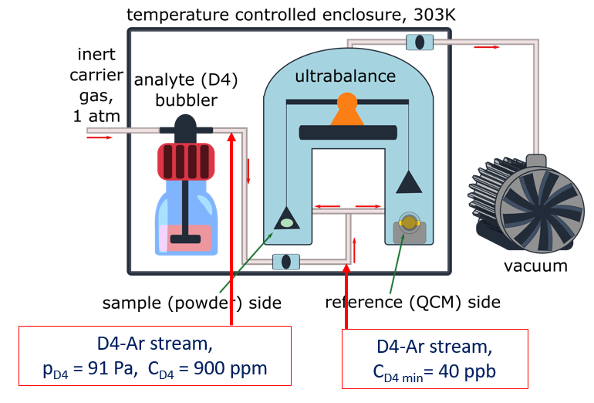
Adsorption: DVS
Porous materials for trapping and detection of space contaminants – CCMPP 2023
Detection
Note : Calibration is required to identify the exact partial pressure of D4 in the carrier gas using a reference material
Notes:
The pressure inside the balance chamber is dynamically adjusted, using a mass flow controller on the inlet side and a butterfly valve on the outlet side that is connected to a vacuum system. Combined with the low-pressure vacuum control of the DVS, which can maintain a total pressure down to 1 Pa, minute concentrations of D4 can be achieved, corresponding to 4 × 10−4 Pa, and equivalent to 40 ppb or 30 μg m−3 at 1 bar and 303 K (30 °C

Slide 15
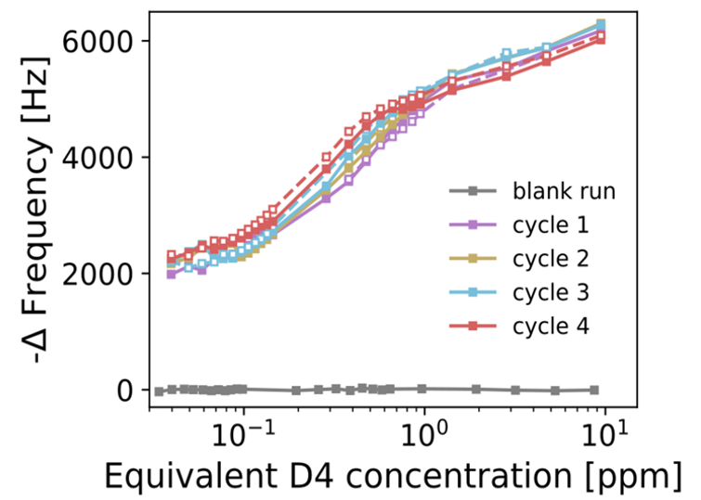
MIL-101(Cr)@QCM for D4 sensing
Porous materials for trapping and detection of space contaminants – CCMPP 2023
Detection
Blank QCM = Negligible response
LOD < 40 ppb
High sensitivity = 1000 & 3000 Hz log10(ppm)⁻¹
Good repeatability
Full reversibility
Full regeneration (vacuum / 303 K)
E. Gulcay, P. Iacomi, G. Rioland, G. Maurin, S. Devautour-Vinot, Airborne toluene detection using Metal-Organic Frameworks, ACS Appl. Mater. Interfaces, Vol. 14, 2022, 48, 53777
P. Iacomi, E. Gulcay, P. Pires Conti, S. Biswas, N. Steunou, G. Maurin, G. Rioland, S. Devautour-Vinot, MIL-101(Cr) MOF as an effective siloxane sensor, ACS Appl. Mater. Interfaces, Vol. 14, 2022, 15, 17531
E. Gulcay, P. Iacomi, Y. Ko, J.-S. Chang, G. Rioland, S. Devautour-Vinot, G. Maurin, Breaking the upper bound of siloxane uptake: metal–organic frameworks as an adsorbent platform, J. Mater. Chem. A, Vol. 9, 2021, 12711

Slide 16

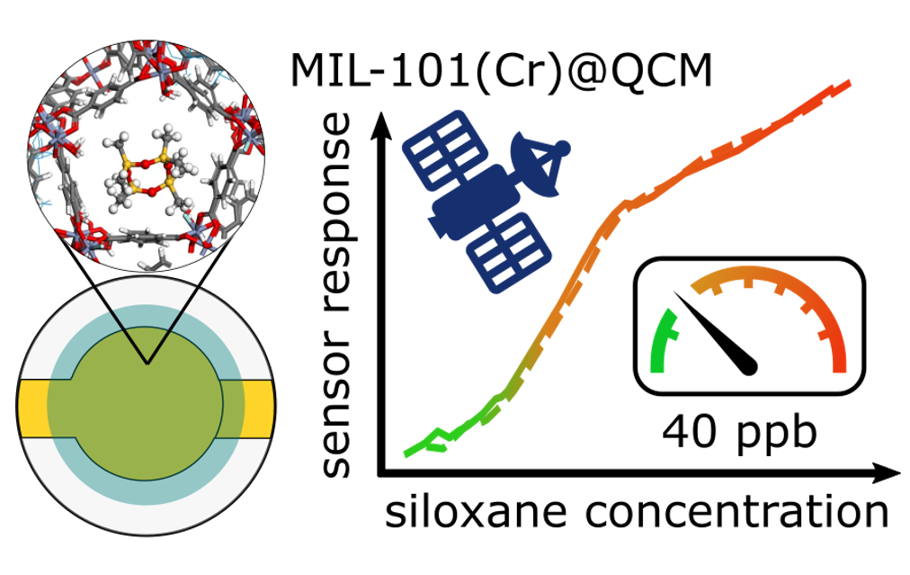

Conclusion
Porous materials for trapping and detection of space contaminants – CCMPP 2023
Trapping:
Zeolite ➙ suitable for numerous contaminants
  Low vapour pressure adsorption
  Customize cations, Si/Al molar ratio…
  Shapes
Ongoing work
  Flight experiment ➔ detection and trapping
  Tests in vacuum chamber
Detection:
MOF selection ➙ high-throughput computational screening (HTCS)
  Geometry, energy, hydrophobicity
MIL-101(Cr)@QCM ➙ suitable for D4 sensing
  Reversibility, sensitivity, repeatability, fast response / recovery times
Ongoing work
  Flight experiment ➔ detection and trapping
  Tests in vacuum chamber and cleanroom
  Other molecules (phthalate, toluene…)
  Surface elastic wave components

Slide 17
Thank you!
CCMPP-2023

